Slide 1

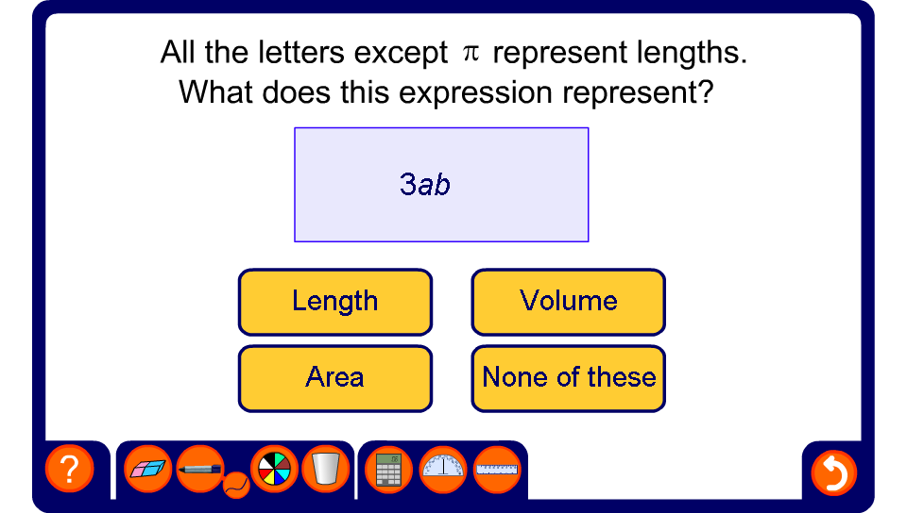


Length, area or volume?

